Slide 1

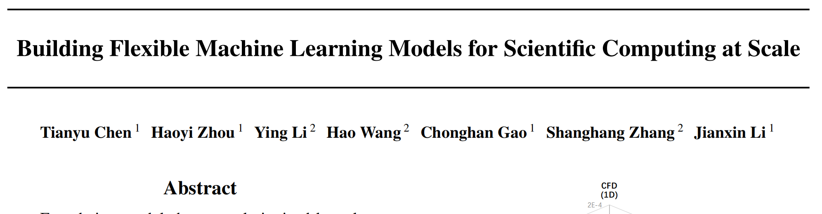
Building Flexible Machine Learning Models for Scientific Computing at Scale

Slide 2
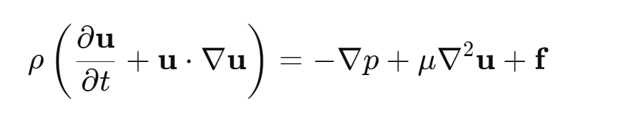
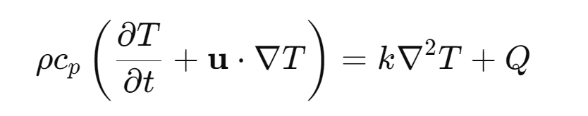
Background
A multiple-physics environment is defined by coupled processes or systems involving more than one simultaneously ocurring physical fields or phenomena.
Such an environment is typically described by multiple patial differentialble equations(PDEs), and tightly coupled .
Solving PDEs presents significant challenges with nonlinearities and time-stepping.
An example:
How to decouple fluid dynamics equation
and heat conduction equation?

Slide 3
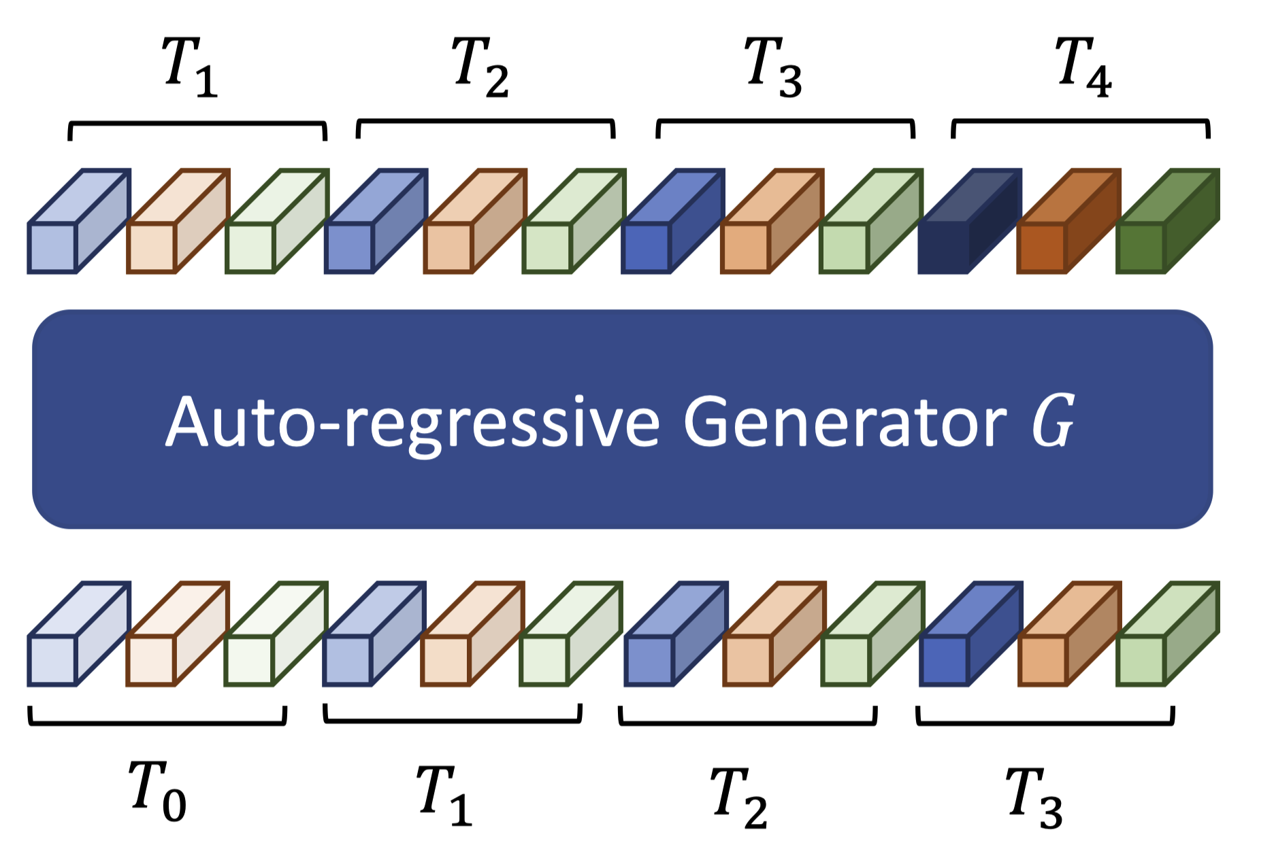
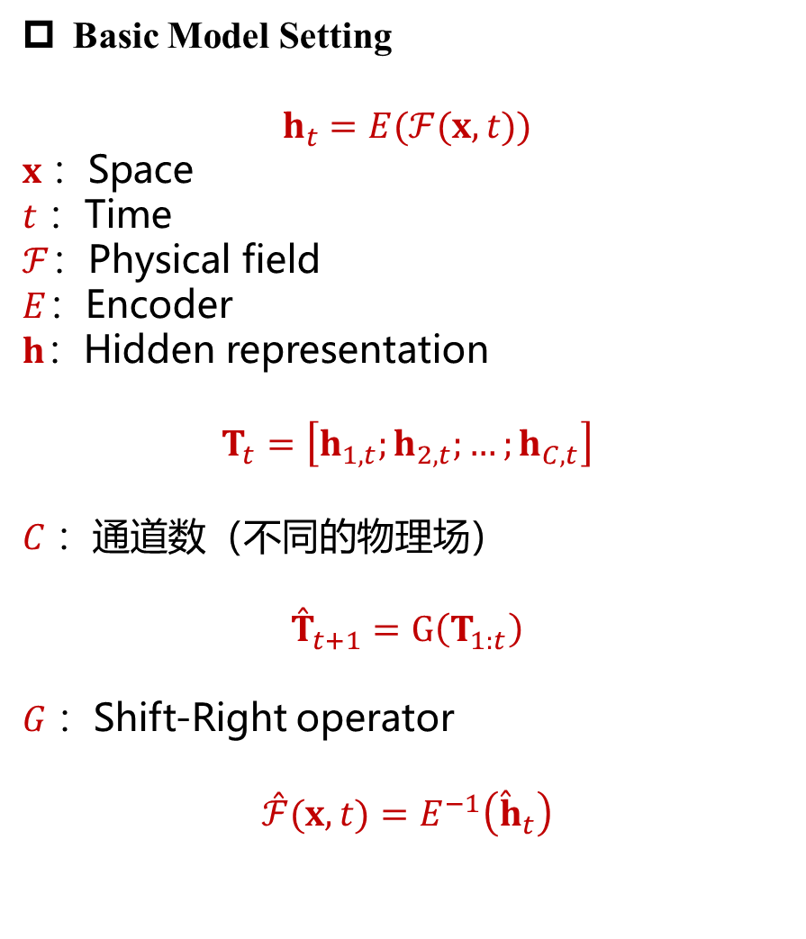
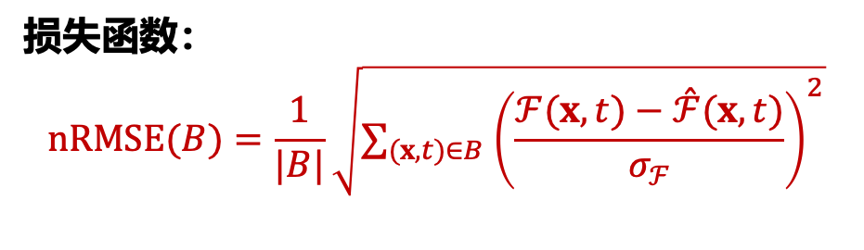
Basic Model Setting
$$h_{t}=E(ℱ(x,t))$$
$x$：Space
$t$：Time
$ℱ$：Physical field
$E$：Encoder
$h$：Hidden representation
$$T_{t}=\left[h_{1,t};h_{2,t};…;h_{C,t}\right]$$
$C$：通道数（不同的物理场）
$${\overset{ˆ}{T}}_{t+1}=G\left(T_{1:t}\right)$$
$G$：Shift-Right operator
$$\overset{ˆ}{ℱ}(x,t)=E^{−1}\left({\overset{ˆ}{h}}_{t}\right)$$
损失函数：
$$nRMSE⁡(B)=\frac{1}{|B|}\sqrt{∑_{(x,t)∈B} {\left(\frac{ℱ(x,t)−\overset{ˆ}{ℱ}(x,t)}{σ_{ℱ}}\right)}^{2}}$$

Slide 4
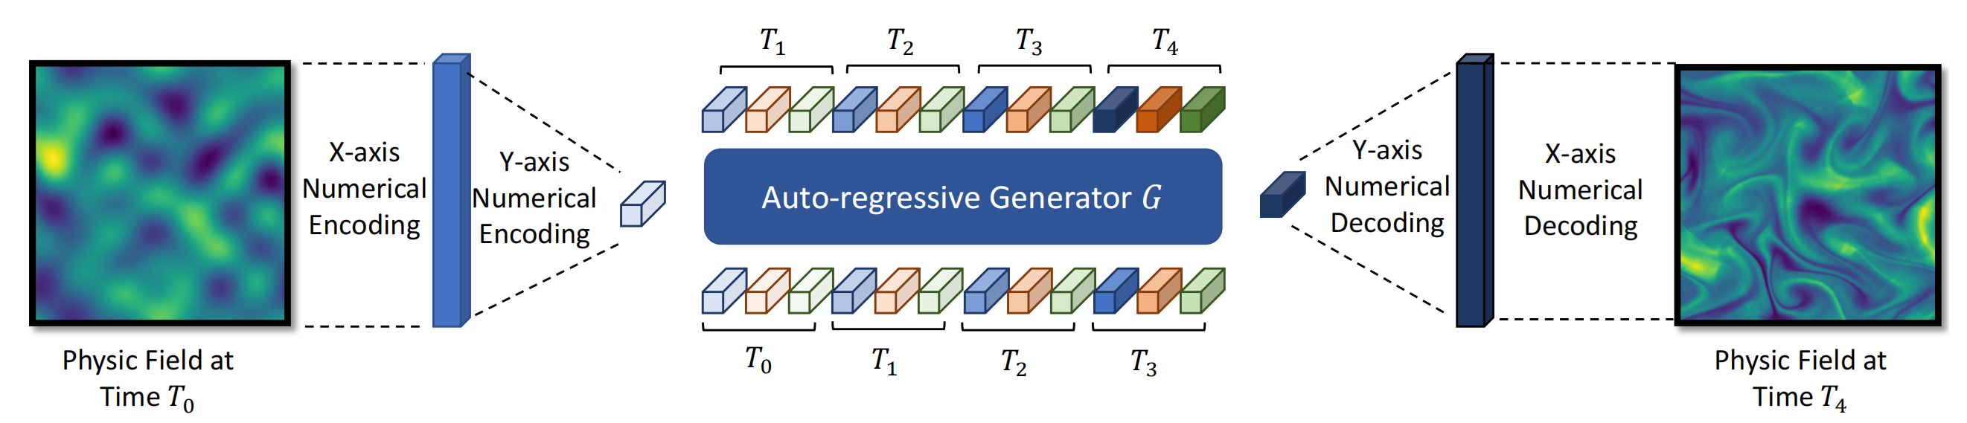
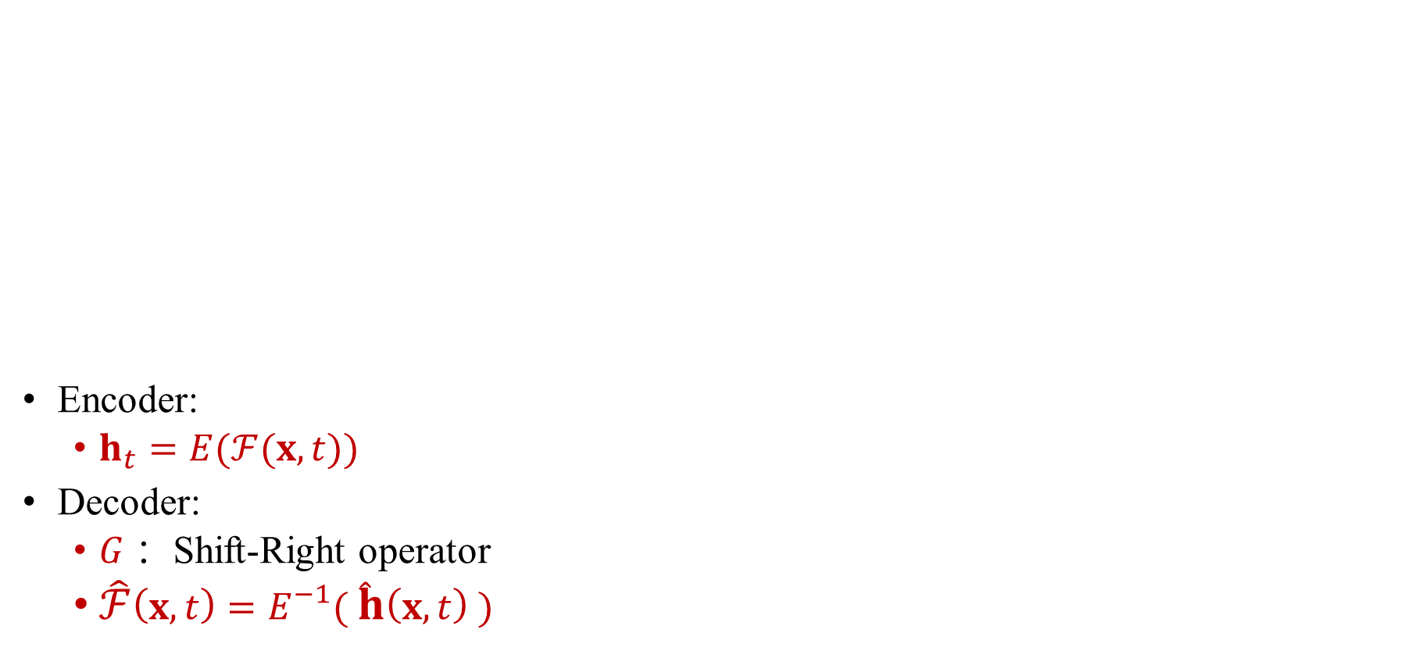
Pipeline - Pretraining
Encoder:
$h_{t}=E(ℱ(x,t))$
Decoder:
$G$：Shift-Right operator
$\hat{ℱ}\left(x,t\right)=E^{−1}( \hat{h}\left(x,t\right) )$

Slide 5
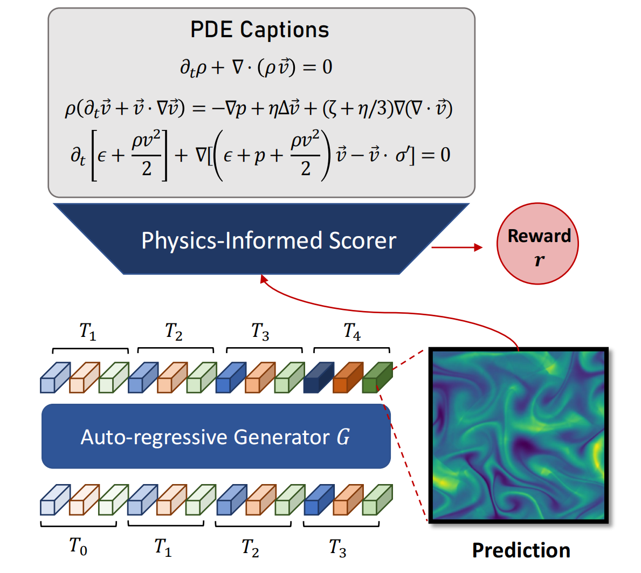
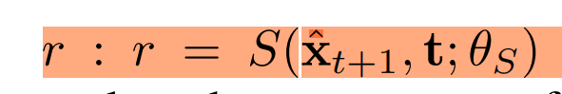
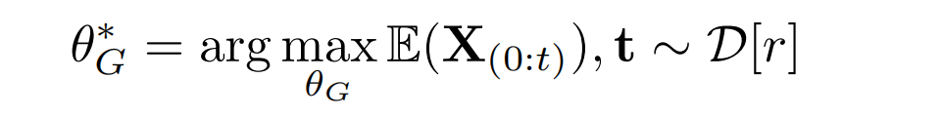
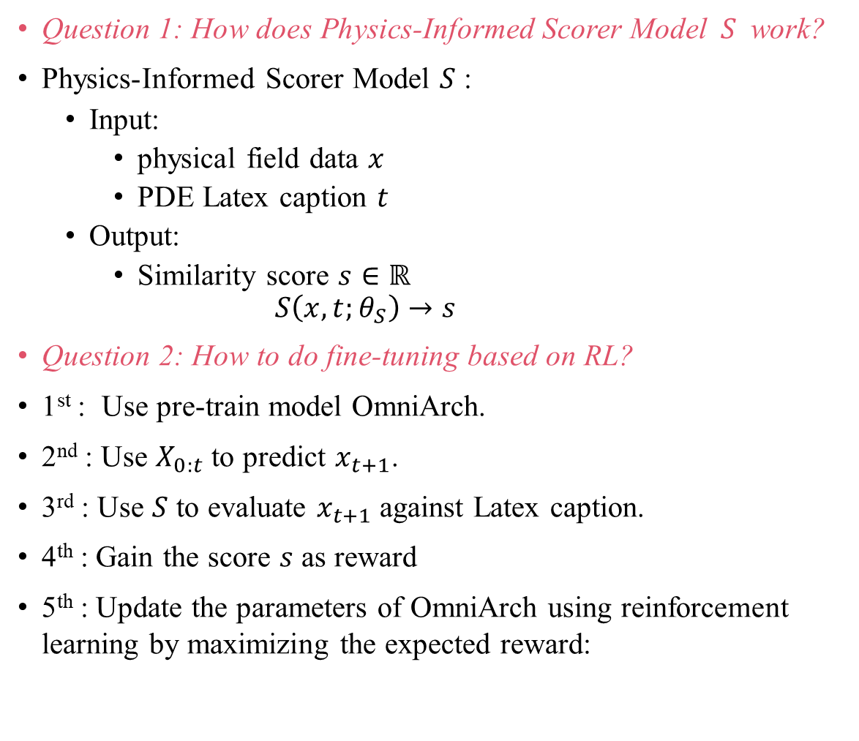
Pipeline – Fine-Tuning(Physics-informed Reinforcement Learning)
Question 1: How does Physics-Informed Scorer Model $S$ work?
Physics-Informed Scorer Model $S$ :
Input:
physical field data $x$
PDE Latex caption $t$
Output:
Similarity score $s∈ℝ$
$$S\left(x,t;θ_{S}\right)→s$$
Question 2: How to do fine-tuning based on RL?
1st : Use pre-train model OmniArch.
2nd : Use $X_{0:t}$ to predict $x_{t+1}$.
3rd : Use $S$ to evaluate $x_{t+1}$against Latex caption.
4th : Gain the score $s$ as reward
5th : Update the parameters of OmniArch using reinforcement learning by maximizing the expected reward:

Slide 6
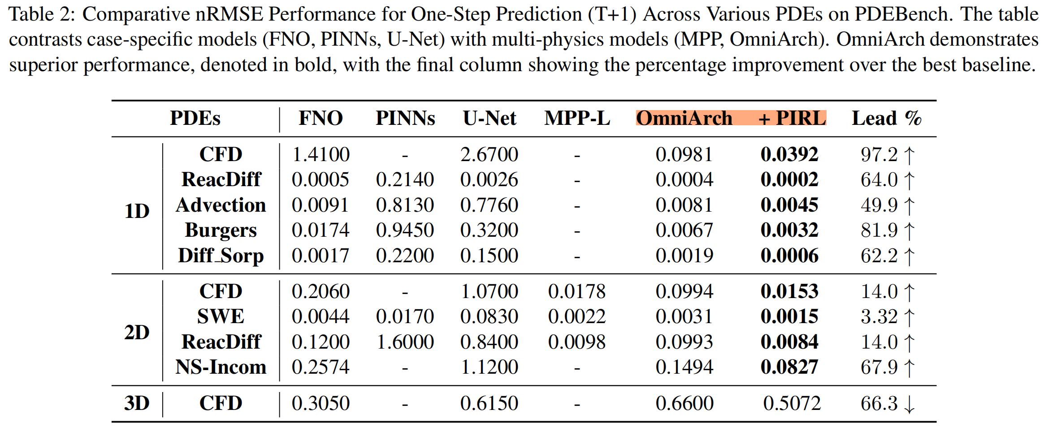
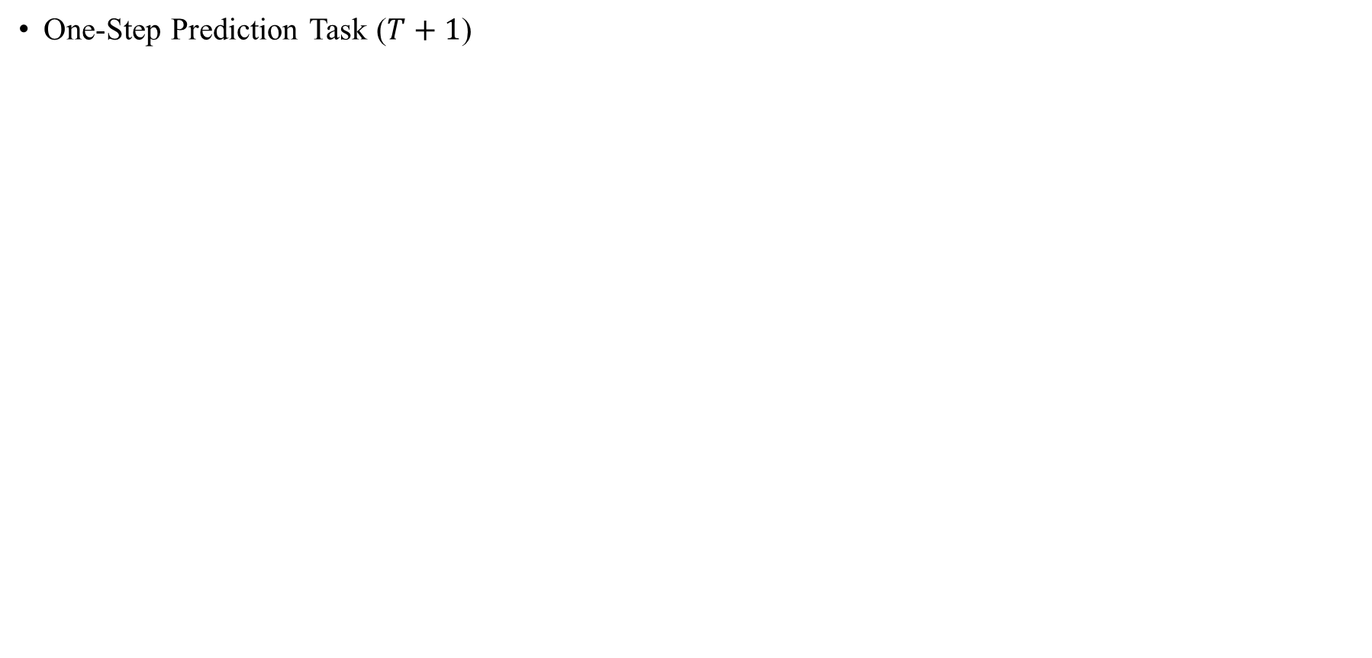
Results – pretrained vs task-tuned
One-Step Prediction Task ($T+1$)

Slide 7
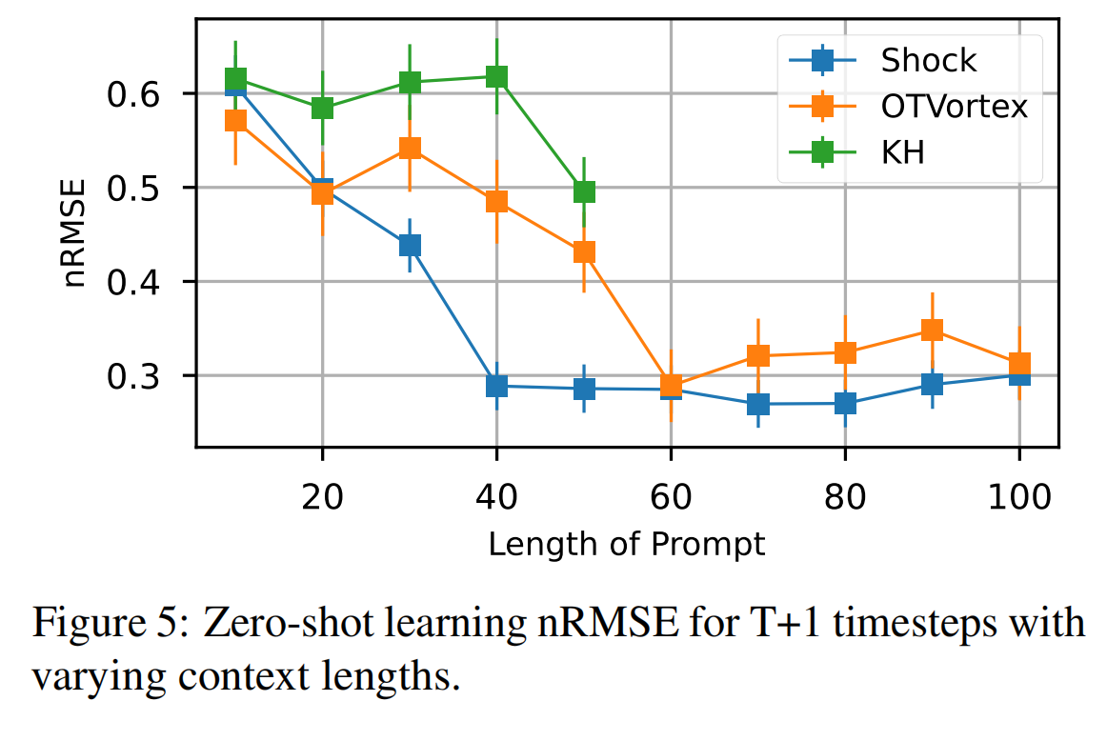
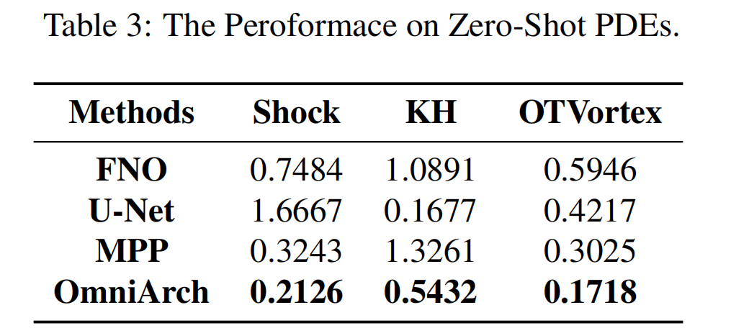
Results - zero-shot learning evaluation
A longer temporal context typically enhances model performance, resulting in lower nRMSE scores across tasks!

Slide 8
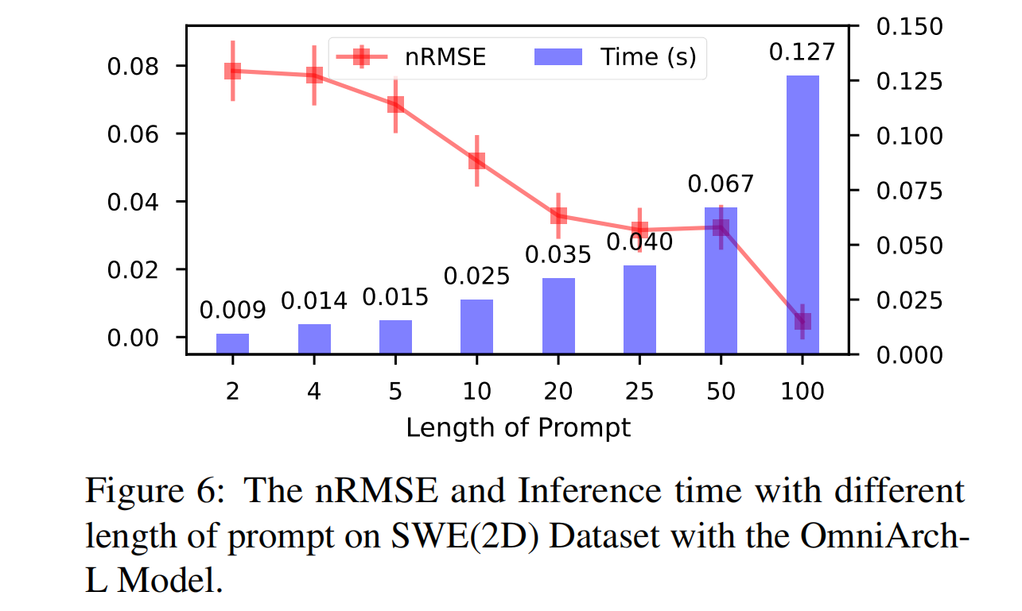
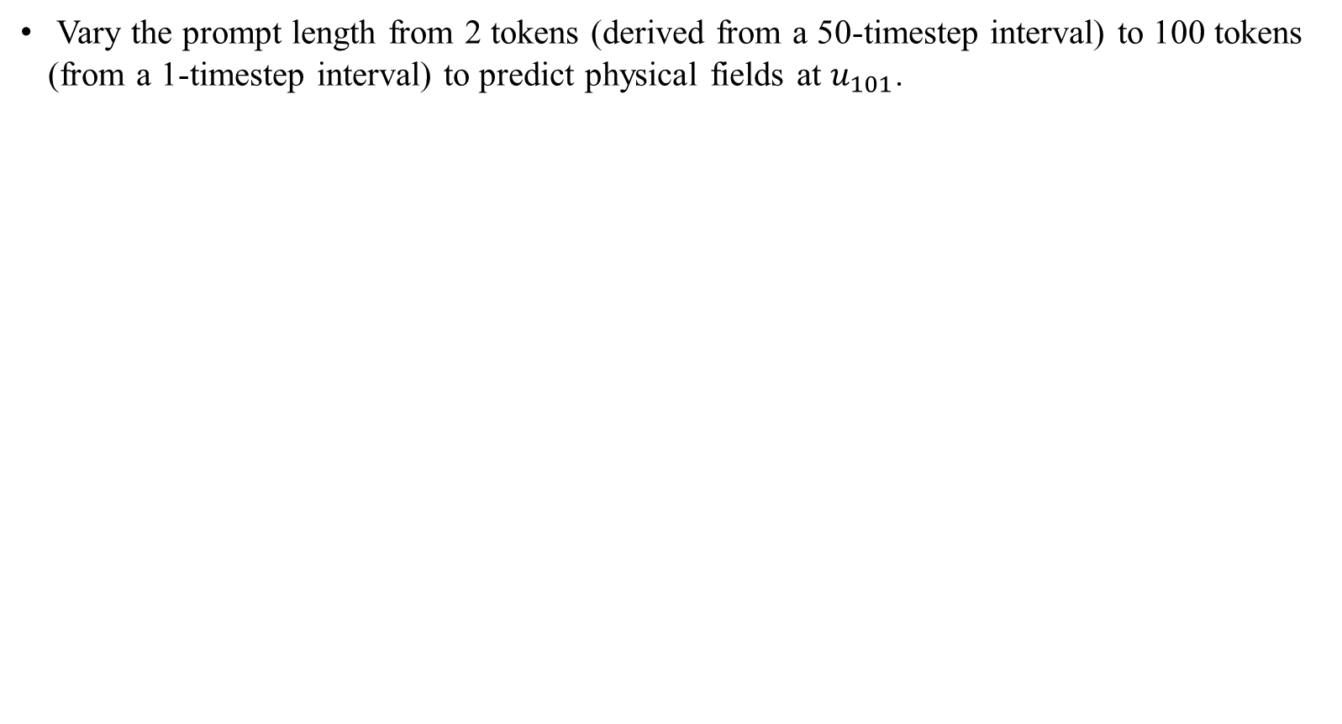
Result – Dynamic prompt length
Vary the prompt length from 2 tokens (derived from a 50-timestep interval) to 100 tokens (from a 1-timestep interval) to predict physical fields at $u_{101}$.

Slide 9
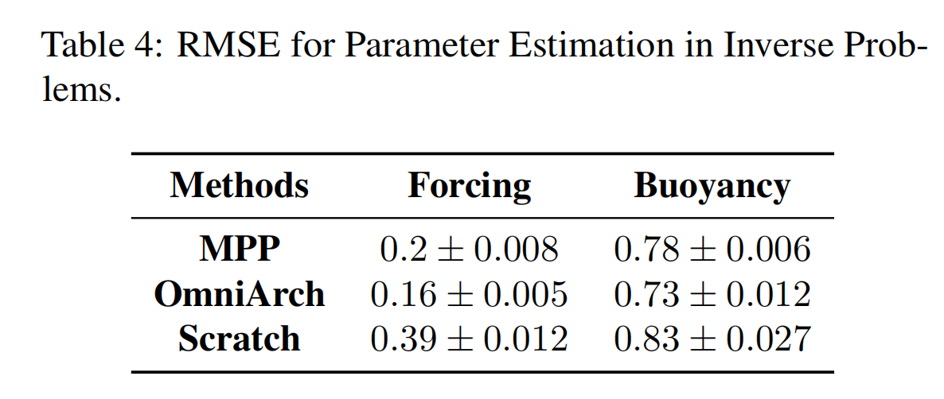
Result – Inverse Problem for incompressible Navier-Stokes equations
Inverse Problem:
1) Forcing Identification
2) Buoyancy Determination.
OmniArch outperforms MPP in parameter estimation tasks, with lower RMSEs values indicating more accurate predictions.

Slide 10
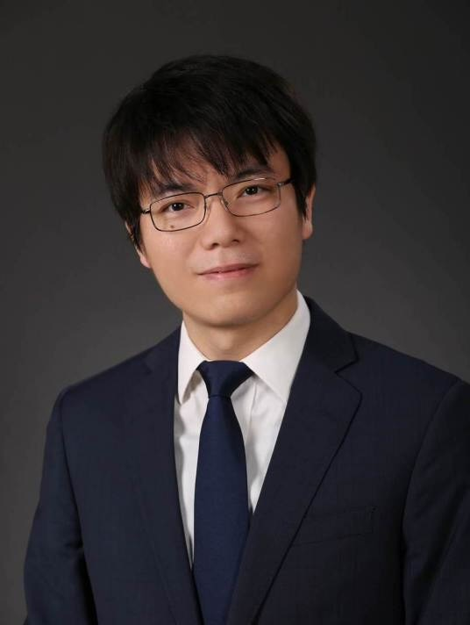
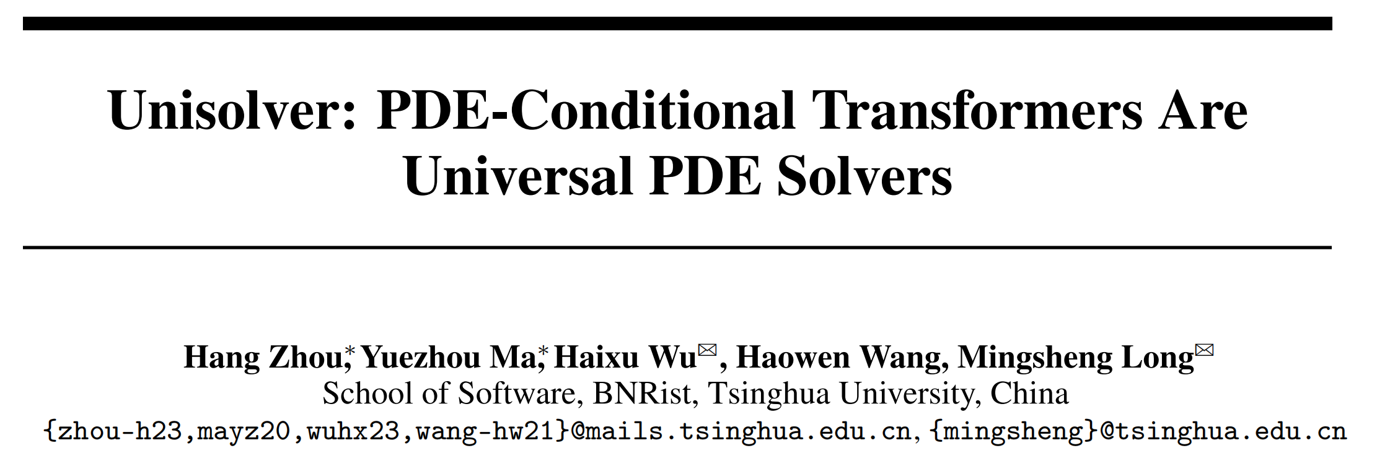
Unisolver: PDE-Conditional Transformers Are Universal PDE Solvers

Slide 11
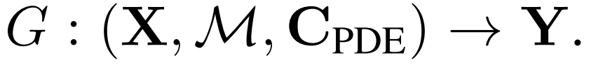
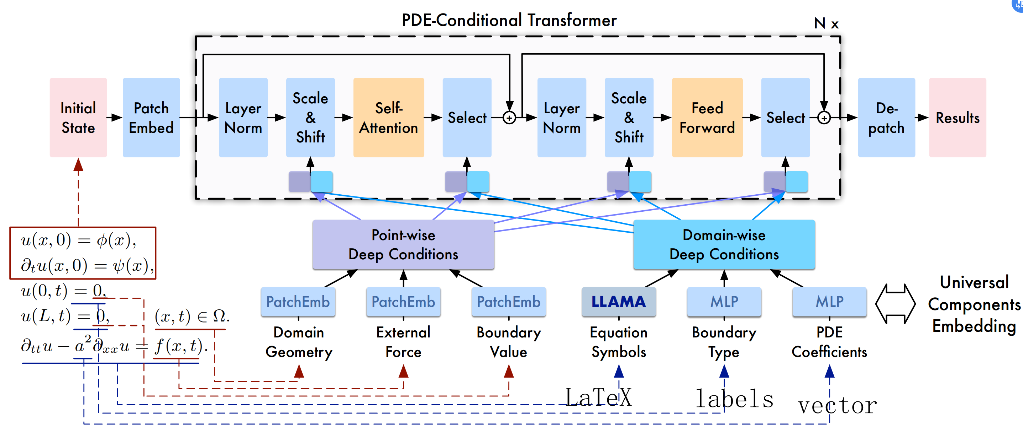
Background
Problem Statement:
For Fluid Mechanism:
Initial
Condition x
Mesh
grid
PDE equations, viscosity coefficients, force term

Slide 12
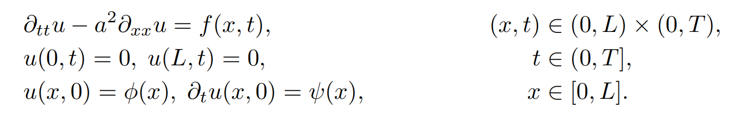
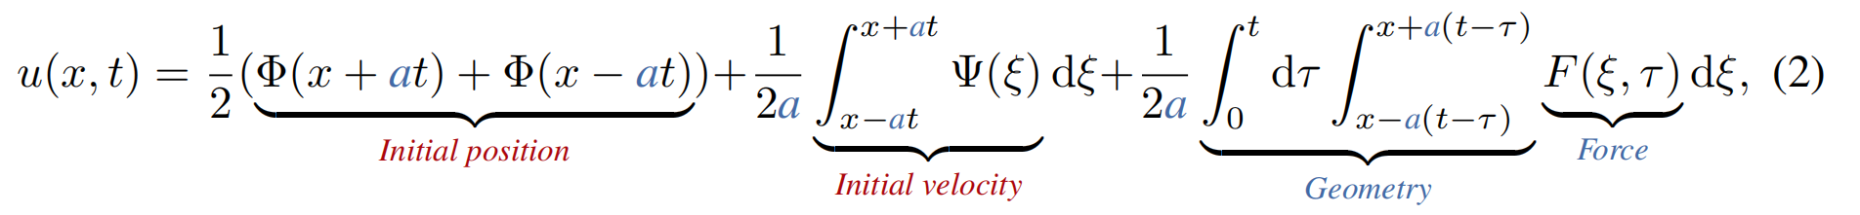
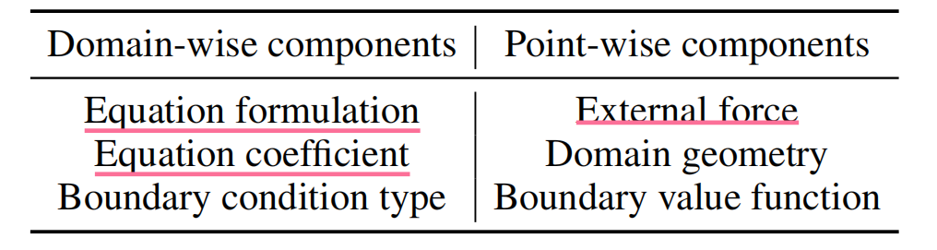
Preparation - Concrete categorization of complete PDE components: domain-wise and point-wise
PDE的某个component是全局一致、还是点一致（即$point_{i}$和$point_{j}$有不同的值）

Slide 13
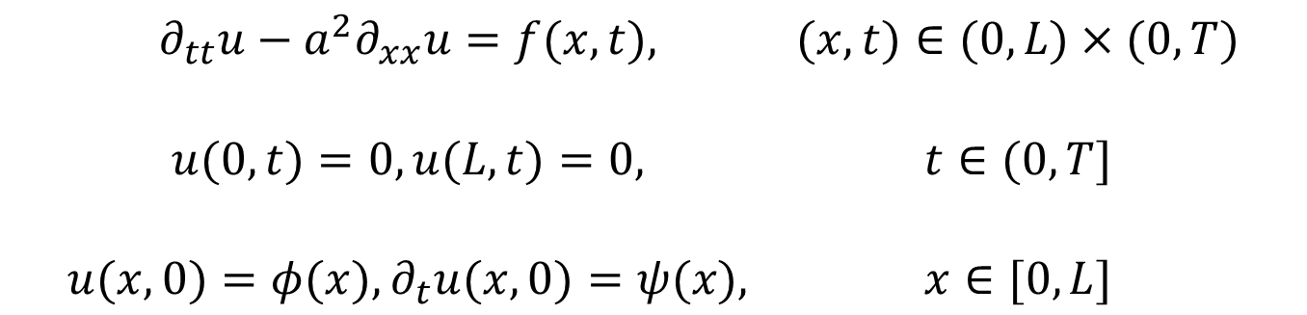
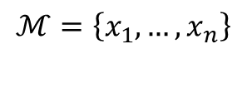
Preparation - Concrete categorization of complete PDE components: domain-wise and point-wise
方程
$$\begin{matrix}∂_{tt}u−a^{2}∂_{xx}u=f(x,t), & (x,t)∈(0,L)×(0,T) \\ \begin{aligned} \\ u(0,t)=0,u(L,t)=0,\end{aligned} & \begin{aligned} \\ t∈(0,T]\end{aligned} \\ \begin{aligned} \\ u(x,0)=φ(x),∂_{t}u(x,0)=ψ(x),\end{aligned} & \begin{aligned} \\ x∈[0,L]\end{aligned}\end{matrix}$$
几何区域
边界条件
初始状态
定义在域上的条件 |  | 定义在点上的条件
方程 | LATEX (LLaMA 3 8B) | 外力 | Real-Valued Vectors
方程系数（具体数值） | Real-Valued Vectors | 几何区域 | A Binary Mask
边界条件类型 | Class Labels | 边界条件（函数） | Real-Valued Vectors (With Zero Values At Non-Boundary Points)
$$ℳ=\left\{x_{1},…,x_{n}\right\}$$

Slide 14
Model Pipeline
定义在域上的条件 |  | 定义在点上的条件
方程 | LATEX (LLaMA 3 8B) | 外力 | Real-Valued Vectors
方程系数（具体数值） | Real-Valued Vectors | 几何区域 | A Binary Mask
边界条件类型 | Class Labels | 边界条件（函数） | Real-Valued Vectors (With Zero Values At Non-Boundary Points)

Slide 15
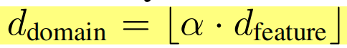
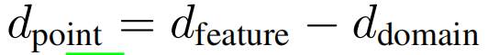
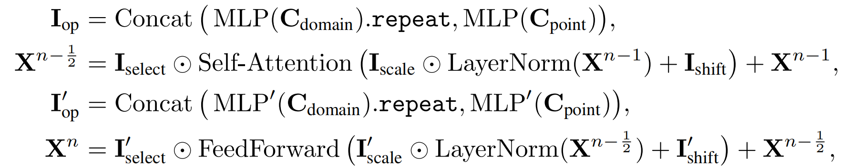
Model Details
Split the hidden inputs along the feature dimension by the domain-wise condition ratio α=0.5:
Overall design:
Suppose there are N layers in the PDE-conditional Transformer architecture, the n-th layer of Unisolver can be formalized as follows:
分配一些注意力头来学习域范围条件的影响，而其他注意力头专注于逐点条件。

Slide 16
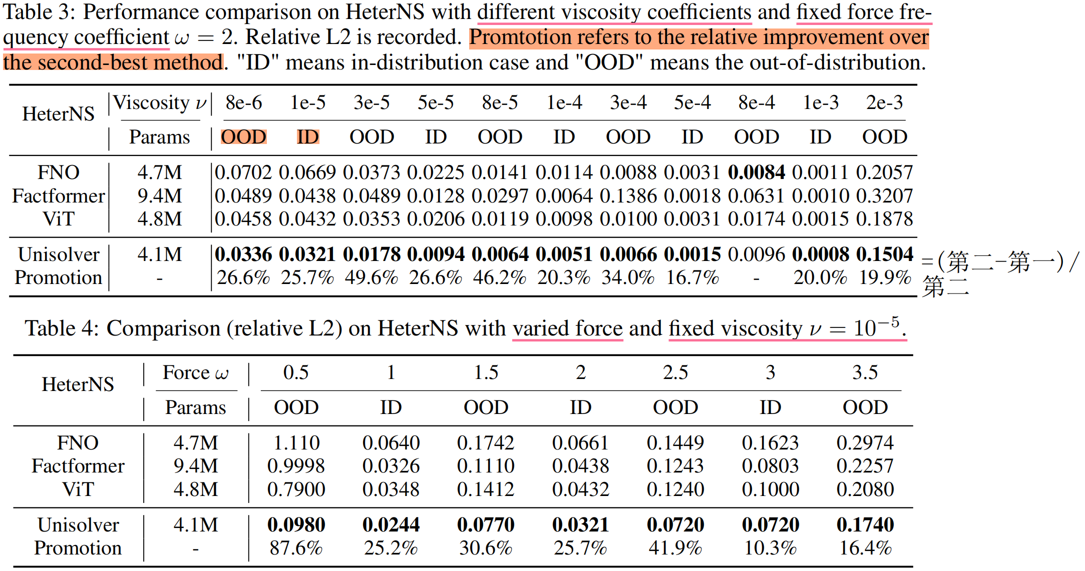
Experiments - Comparison with baseline

Slide 17
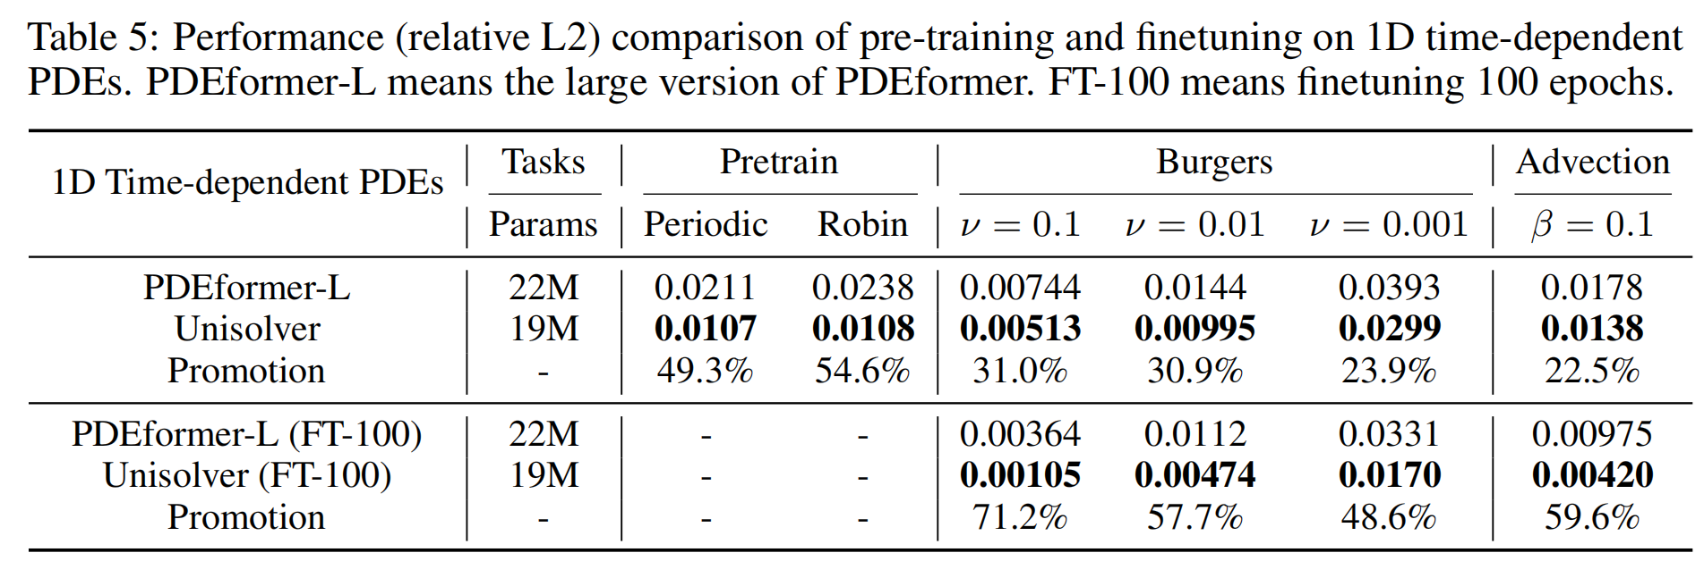
Experiments - 1D Time-dependent PDEs
UniSolver achieves better performance in zero-shot evaluations on downstream tasks, with an average improvement of 27.1% over PDEformer-L!

Slide 18
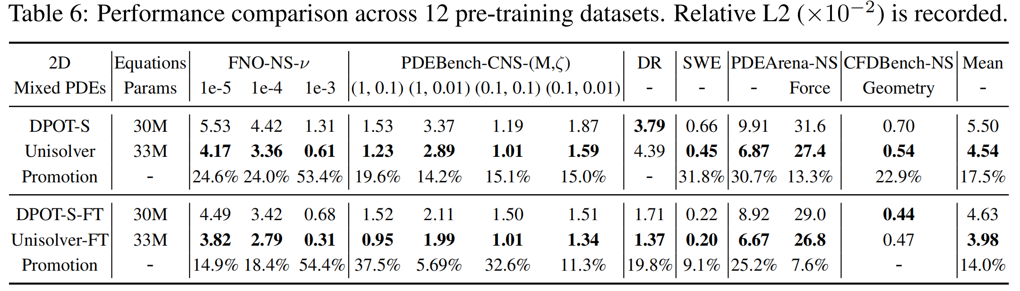
Experiment - 2D Mixed PDEs
Outperforms DPOT in 11 out of 12 datasets except for a small dataset DR

Slide 19
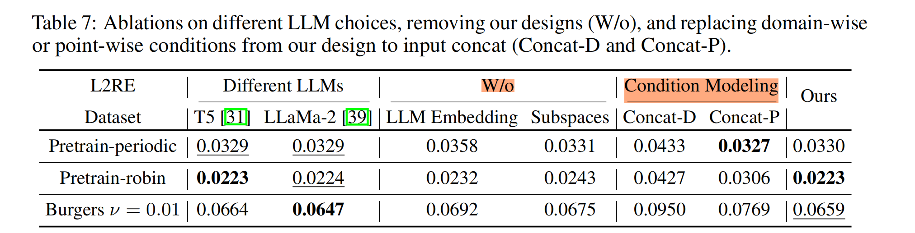
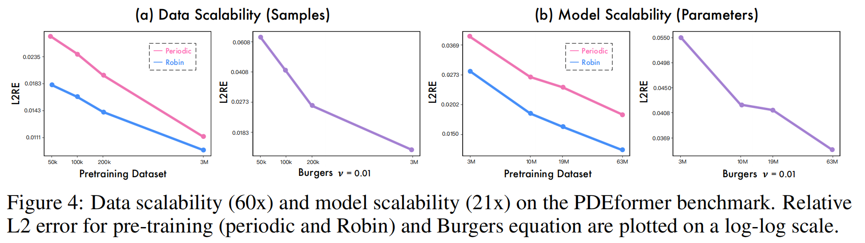
Experiment – Ablations & Scalability

Slide 20
DPOT: Auto-Regressive Denoising Operator Transformer for Large-Scale PDE Pre-Training
许笑颜
xxy1101@mail.ustc.edu.cn

Slide 21
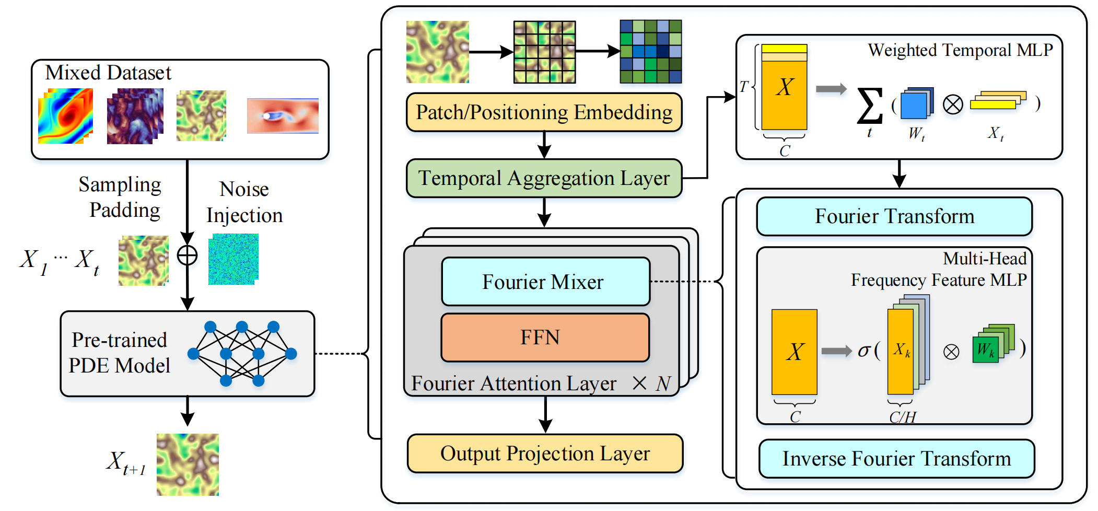
Model Pipeline

Slide 22
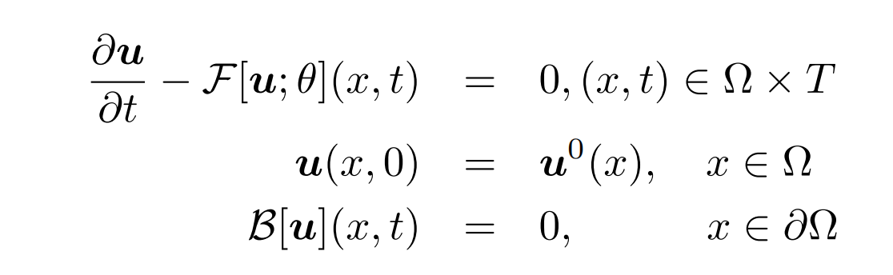
Problem Form
General Form of parametrized time-dependent PDEs:
: differential operator.
$D=\bigcup_{k=1}^{K}{D_{k}}$: Pde Dataset, $D_{k}={\left\{u_{i}\right\}}_{1≤i≤N_{k}}$.
$u_{i}=(u_{i}^{1},…,u_{i}^{T})$: Discrete Solutions.
$u_{j}^{t}$: 时间步 $t$ 在 $x_{j}$ 网格点的解
Boundary condition

Slide 23
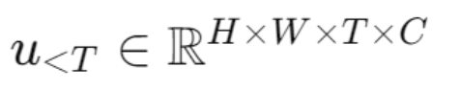
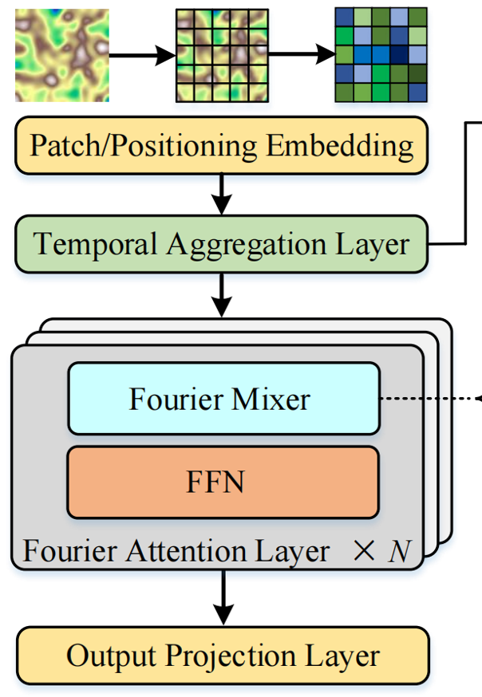
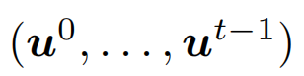
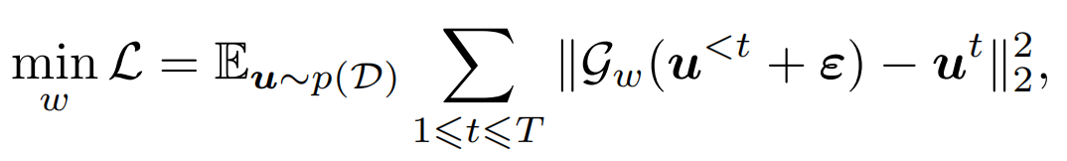
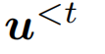
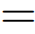
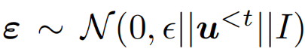
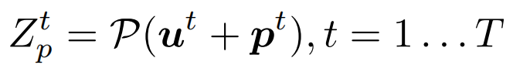
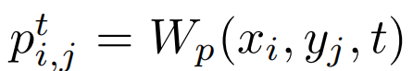
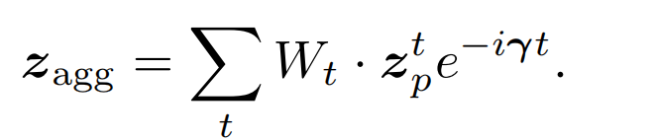
Model Architecture
Input Encoding and Temporal Aggregation
Input: Spatial Data
Add Noise & Denoise: injecting small-scale noise into the inputs
Patch Layer:
Time Aggregation:
Noise!
Optimization Object !
Positional encodings

Slide 24
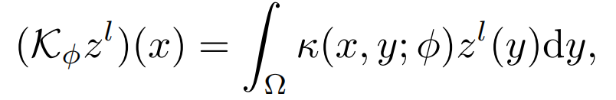
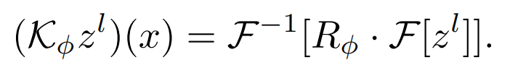

Model Architecture
Fourier Attention Layer
kernel integral transform
frequency domain transformation
Update the hidden representation $z^{l}(x)$ in a Fourier attention layer
Multi-head Structure

Slide 25

Experiments & Results
Pre-trained & non-pre-trained small models

Slide 26

Experiments & Results
Fine-tuning results(downstream tasks)
training the DPOT from
scratch for 500 epochs
training for the same number of steps but using pre-trained weights for initialization

Slide 27

Experiments & Results
Scaling law
Before Fine tuning
After Fine tuning

